Slide 1
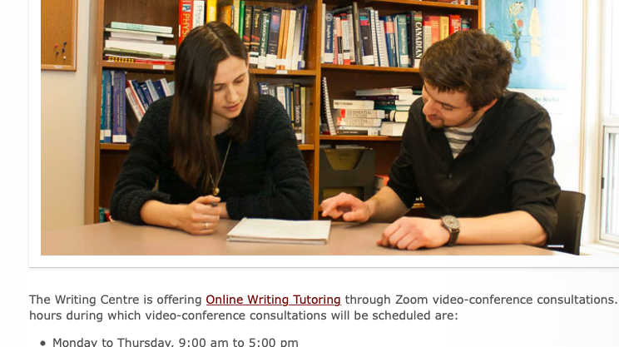
Writing Centre
at The University of Winnipeg

Slide 2
What we do
The goals of the Writing Centre are:
facilitate the processes that leads you to being a better writer,
help you to become better at identifying problem spots in your own writing,
create a customized session for you, focusing on writing concerns such as organization, argument development, supporting claims, specifics of working within an academic genre, audience awareness, and developing critical thinking,
help you become a better editor of your own work, and
help you gain confidence in your writing ability.

Slide 3
What we don’t do
We do not proofread or edit students’ papers.
Instead, we will work with you to help you learn about writing, discover areas in which your writing can improve, and learn about how to resolve issues in your writing.
We do not promise a good grade.
We are not the graders of your papers.

Slide 4
How to make an in person or online appointment
Book an Appointment
https://www.uwinnipeg.ca/writing-centre/make-an-appointment.html

Slide 5
In person and Zoom video-conference consultations
The Writing Centre is offering in person and Online Writing Tutoring through Zoom video-conference consultations.
In Person: Monday, Tuesday, Thursday, and Friday 9:00 am to 5:00 pm
Online: anytime
Please note: It may take up to 72 hours until a confirmation of a Zoom appointment time is sent. Please have the Zoom application installed on your computing device (it can be installed on Windows, all Apple devices, and Linux).

Slide 6
Writing Centre link:
https://www.uwinnipeg.ca/writing-centre/make-an-appointment.html

