Slide 1
Report to Faculty of Arts Council
April 23, 2025

Slide 2
Who is Arts Faculty Council?
Dean as Chair (1)
Associate Dean (1)
Department Chairs (15)
Graduate Chairs (7)
Program Coordinators (6)
RAS (~170)
CAS (147)

Slide 3
Members of the Arts’ Office

Slide 4
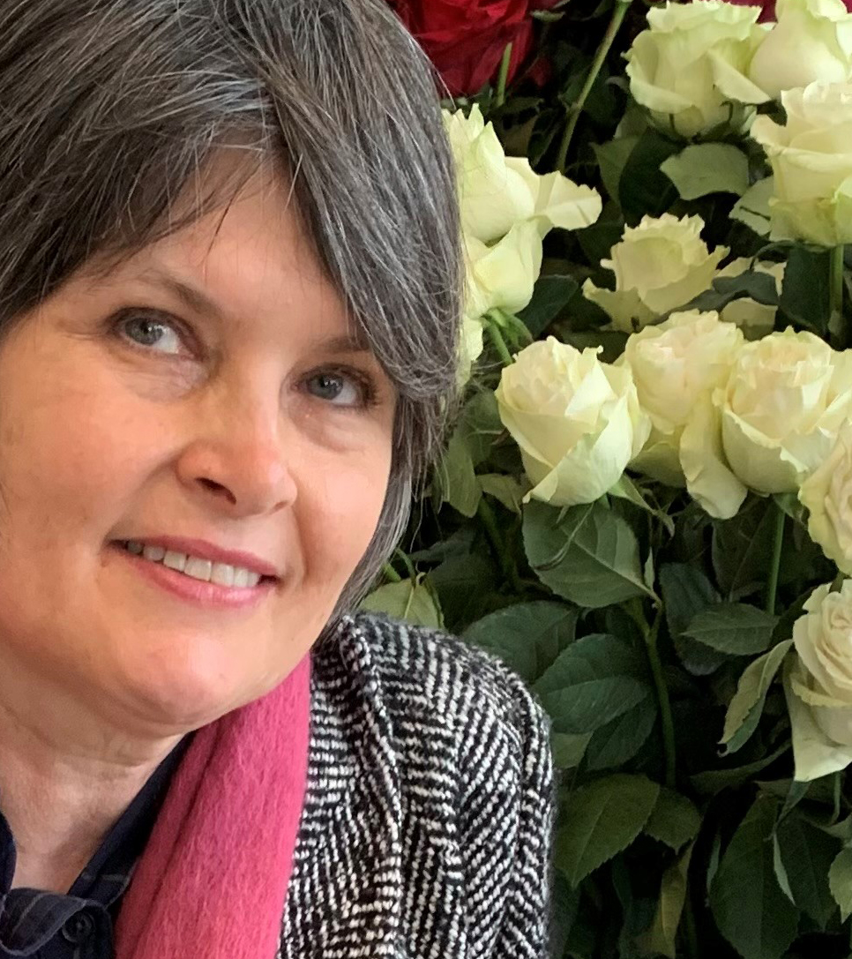
Lisa Mclean
Budget
Staffing
Website
Newsletter
Office Management

Slide 5
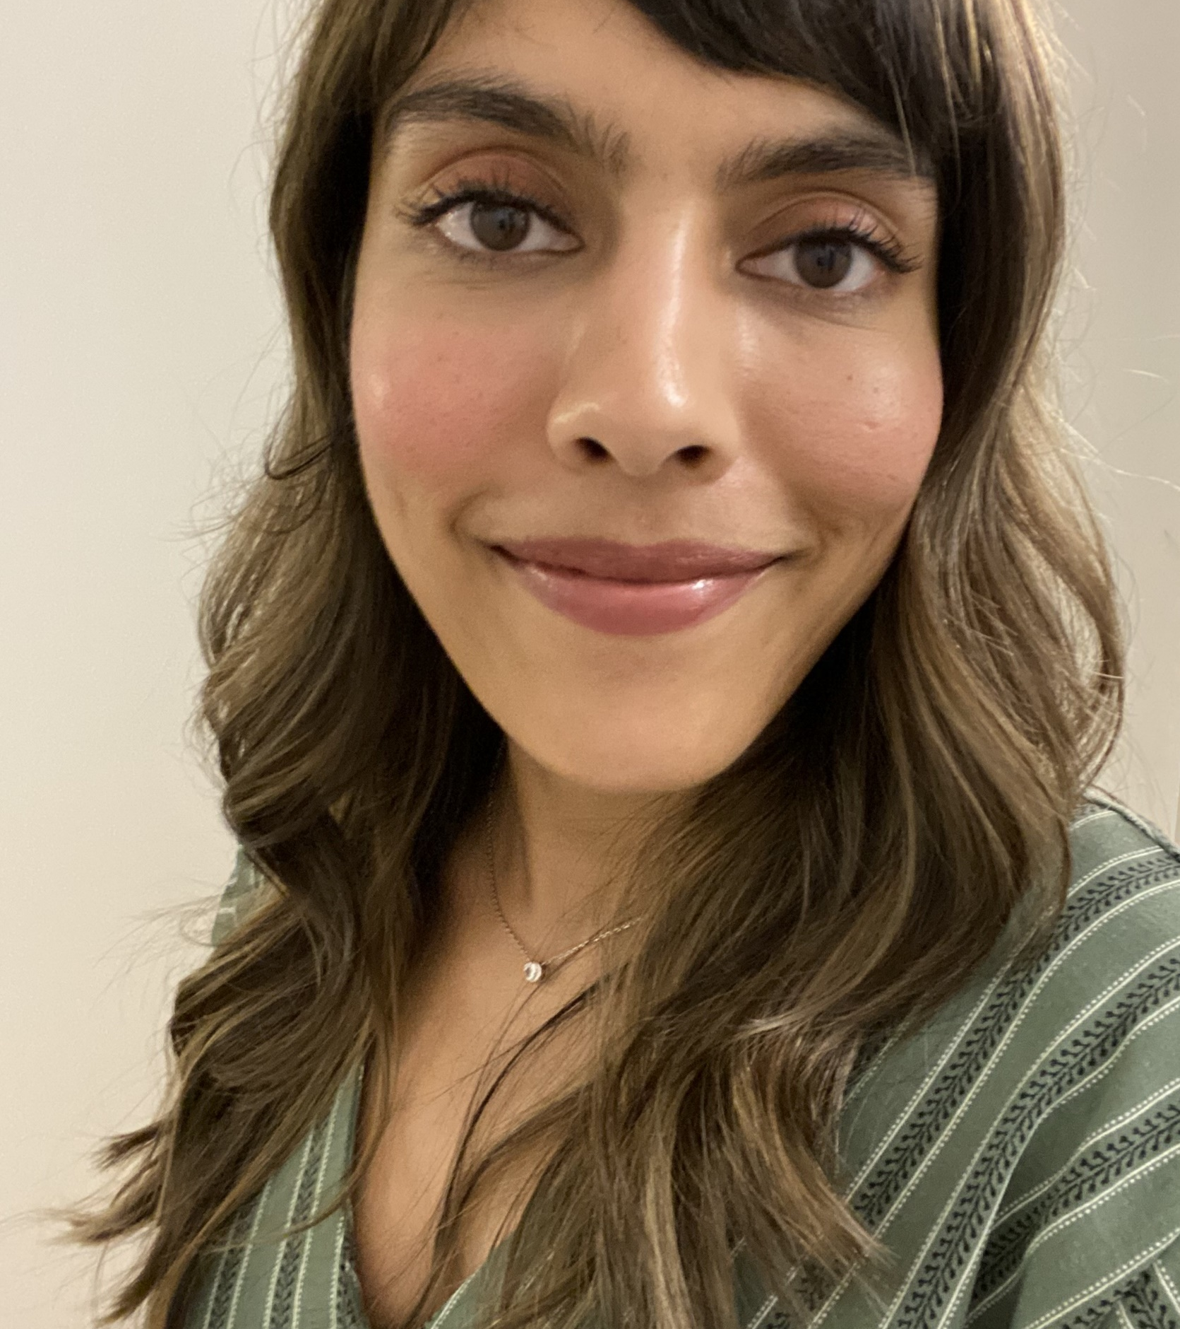
Shivani Bhukhureea
Administrative support to the Deans
Personnel Files
Tenure and Promotion
Study Leave
Arts Council/Arts Faculty Council

Slide 6
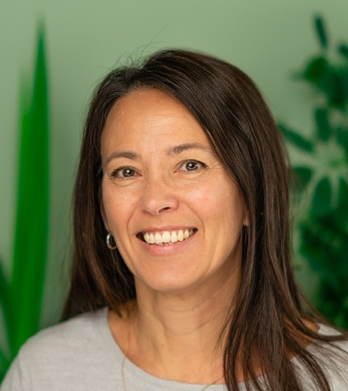
Jackie Benson
Senate Curriculum Committee
CAS contracts
SASMC
TPDA (Arts)

Slide 7

Nyala Ali
Experiential Learning Coordinator
Supports Arts professors as they develop and implement internships, field courses other forms of hands-on learning
Connects undergraduate students with local placement opportunities
Manages the yearly EL grant fund competition

Slide 8
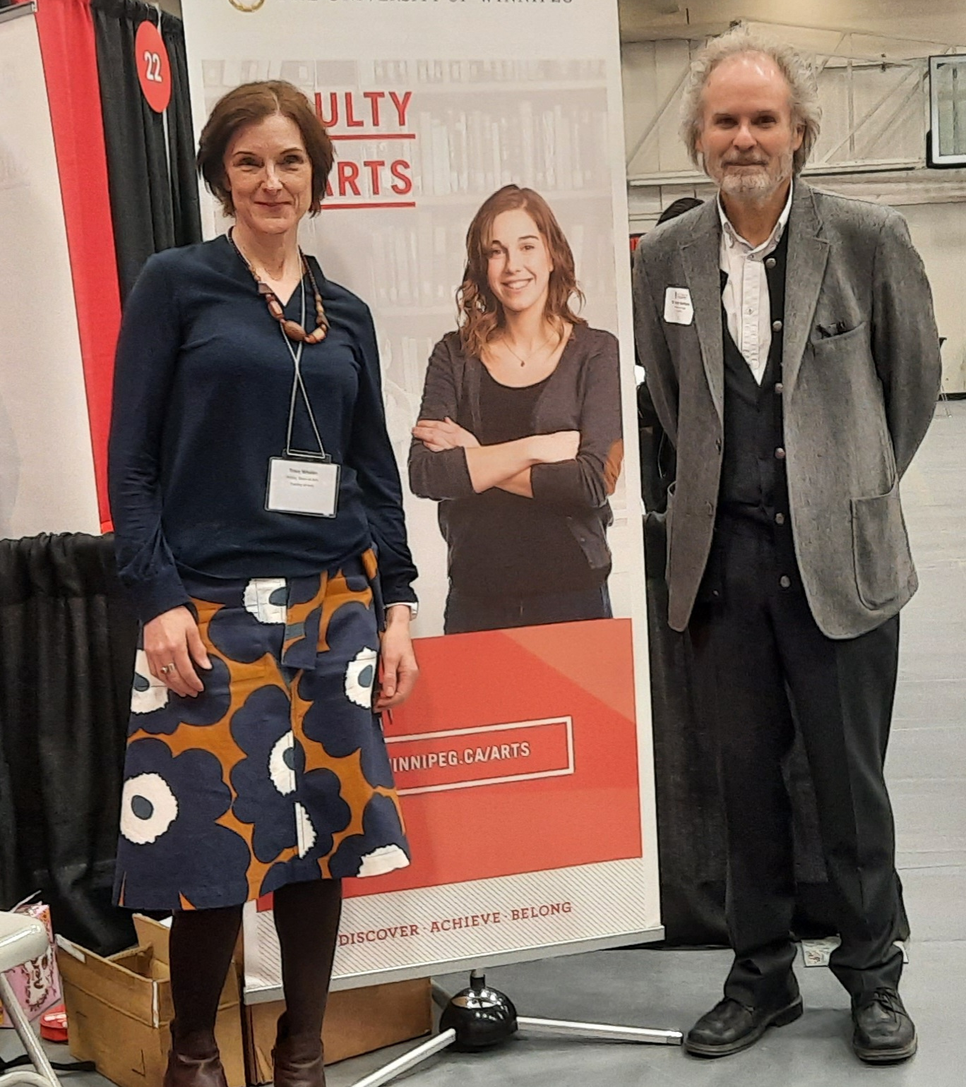
Your Deans
Tracy Whalen,
Dean of Arts
James Hanley,
Acting Associate Dean of Arts

Slide 9
2024-2025 year in review

Slide 10
Curriculum [from May 2024-April 2025]
153/159 (123)* credit hours of new courses
219/228 (245)* credit hours of revisions
45 (132)* credit hours of deletions
54/57 (21)* credit hours of experimental courses
9 (3)* credit hours of courses rendered inactive
3 credit hours of new ICR-designated courses
* figures from 2023-24

Slide 11
Contract Academic Staff
For the 2024-25 Fall/Winter term, Arts processed
298 CAS agreements,
30 lab contracts, and
5 RAS overload stipends.
Of the 298 CAS agreements, 140 CAS members were hired to teach.
For Spring 2025, Arts processed
47 CAS agreement letters, and
2 lab contracts.
Of the 47 CAS agreement letters, there were 7 CAS Members who didn’t teach for us in the Fall/Winter term.

Slide 12
Senate Academic Standards and Misconduct
From May 2024 to April 10, 2025, SASMC reviewed 141 cases of academic misconduct. [Last year there were 179 cases.]
There were 20 cases in which the SASMC determined insufficient evidence to conclude academic misconduct had occurred.
There was 1 case where the SASMC declined to proceed as it was not course related. The case was referred to the Registrar as a matter of non-academic misconduct.
Of the 141 cases, there were 8 cases of aiding and abetting/file sharing, 30 cases of cheating, 9 cases of falsification, 9 cases of improper research/academic practices, and 85 cases of plagiarism, which included using generative AI.
Last year, the SASMC reviewed 179 cases of academic misconduct.

Slide 13
Applications
Study leave applications (28)
Applications for tenure, promotion, continuing appointment, and conversion (15)

Slide 14
Contributions to Strategic Directions

Slide 15
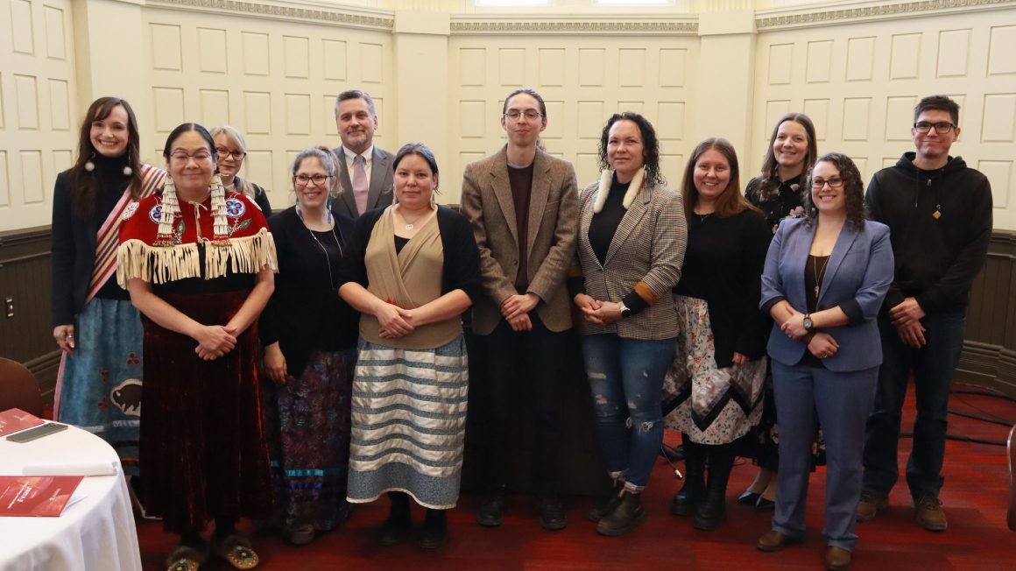

Slide 16
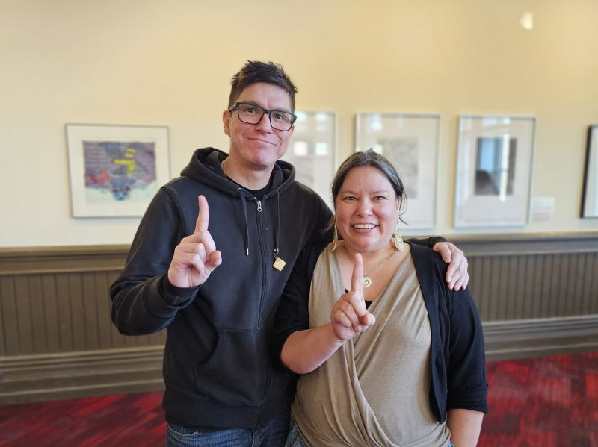

Slide 17
INDIGENIZATION
New permanent ICR course
UIC‐2035(3)/HIST-2613(3)
History of Indigenous Institutional Development in Winnipeg
Indigenous peoples in Manitoba's largest urban centre have long been challenging systemic racism and colonial structures. In this course students learn about the rich history of lndigenous-led resistance and development in Winnipeg from 1950 and into the 2000s. Topics include the development of the Indian Métis Friendship Centre, the Ma Mawi Wi Chi Itata Centre, Children of the Earth School, Native Women's Transition Centre (now Indigenous Women's Healing Centre), and Neeginan Centre. Students also learn about a new generation of Indigenous leaders building spaces of hope and resistance in Winnipeg's inner-city neighbourhoods.

Slide 18
Indigenous Initiatives
Last fall, the Department of Indigenous Studies hosted Dr. Michael Yellow Bird, Professor and former Dean of Social Work at the University of Manitoba, for his talk on neuro-decolonization and Indigenous mindfulness.

Slide 19
BIPOC Initiatives and Events Funding
Public Reading, Poet Laureate Chimwemwe Undi (Feb. 25)
Black History Month Event, Empowering Voices: Amplifying Black Narratives in Leadership (Feb. 28)
3. Public Talk and Classroom Session, Dr. Paul Gareau (March 13-15)
“Relationality and Religion: Thinking With Critical Indigenous Studies” (public lecture in Religion and Culture Studies)
4. Workshop, The Final Report from the Special Interlocutor for Missing
Children and Unmarked Graves and Burial Sites associated with
Indian Residential Schools (April 24-25)

Slide 20
ACADEMIC EXCELLENCE AND RENEWAL
Chair Succession
Adam Parboosingh started a 3-year term as Chair of Theatre and Film on January 1, 2025.
Brandon Christopher will start a 3-year term as Chair of English starting July 1, 2025.
Carlos Colorado will start a term as Chair of Religion and Culture starting July 1, 2025.
Kristin Lovrien-Meuwese will start a 3-year term as Chair of Modern Languages and Literatures starting July 1, 2025.

Slide 21
ACADEMIC EXCELLENCE AND RENEWAL
Experiential Learning: Fully funded Projects
Andrew Burke, Faculty of Arts – English
Project: “Residual Media”
Will Burton, Faculty of Education - Education
Project: “Place Based Experiential Learning”
Bruno Cornellier, Faculty of Arts – English
Project: “Capstone Seminar in Cultural/Curatorial Studies: Symposium”
Wayne Davis, Faculty of Education - Education
Project: “Nelson House Experiential Learning”
Paul DePasquale, Faculty of Arts - English
Project: “Experiential Learning in Topics in Indigenous Texts and Cultures: Indigenous Health”

Slide 22
ACADEMIC EXCELLENCE AND RENEWAL
Experiential Learning: Fully Funded Projects
Patricia Fitzpatrick, Faculty of Science - Geography
Project: “Geography & Environmental Science Internship Course”
Tina Greenfield, Faculty of Science – Anthropology
Project: “Archaeological Field School at Piapot First Nation: an introduction to conducting searches of IRS unmarked graves using subsurface technology”
Hope McIntyre, Faculty of Arts – Theatre and Film
Project: “Responsible Theatre Practices”
Melanie Racette-Campbell, Faculty of Arts – Classics
Project: “Ancient Roman History and Culture in Context: Learning in the City of Rome”

Slide 23
ACADEMIC EXCELLENCE AND RENEWAL
Experiential Learning: Fully Funded Projects
Bong-gi Sohn & Helen Lepp-Friesen, Faculty of Arts – Rhetoric & Writing
Project: “Beyond Borders: Writing Pathways for English as an Additional Language Students”
Eric Thrift, Faculty of Science – Anthropology
Project: “Museum Anthropology Lab Development”

Slide 24
STUDENT EXPERIENCE AND SUCCESS
Theatre and Film
In February, the Acting III: Honours class presented Forward by Chantal Bilodeau and directed by faculty member Hope McIntyre.
From April 1 to 5, 2025, the Department presented White Girls in Moccasins, a play by Yolanda Bonnell, who is a Bi/Queer 2 Spirit Anishinaabe-Ojibwe, South Asian mixed performer, playwright and multidisciplinary creator/facilitator.
The Acting III: Advanced class presented The Brothers Grimm Spectaculathon, a one-act comedy by Don Zolidis, that ran April 12 & 13, 2025 and was directed by faculty member Hope McIntyre.

Slide 25
STUDENT EXPERIENCE AND SUCCESS
Publications
Rooted in Rhetoric (vol. 9) was published in 2024
Crossings (vol. 7) was published in August 2024
Juice (vol. 23) was released in Fall 2024. The theme was "consumption" and this year, they are focusing on publishing prose and poetry on ableism and mental health.

Slide 26
STUDENT EXPERIENCE AND SUCCESS:
Colloquia and Projects
The Department of Women’s and Gender Studies and Disability Studies held their annual student colloquium on April 24, a day-long come & go event that explored critical feminisms and disability studies.
Criminal Justice held their annual CJ Day on April 8, 2025, their “thesis presentation event celebrating the hard work and research of Criminal Justice Honours students”
UWinnipeg’s Psychology Department’s Prairie Undergraduate Research Conference will be held on Friday, April 25, 2025.
As part of their work in the REL/EALC-3970 course on "Art and Meditation in Buddhism", students created a collective art project titled Ensō: A Meditation on an Interconnected World.

Slide 27
STUDENT EXPERIENCE AND SUCCESS
Carol Shields Writer-in-Residence
The 2025 Carol Shields Writer-in-Residence (online) was Sharon Bala. Sharon Bala is known for her “best-selling debut novel, The Boat People, [which] won the 2020 Newfoundland & Labrador Book Award and the 2019 Harper Lee Prize for Legal Fiction, was short listed for several awards, and is in translation in four languages. She won the Writers' Trust/McClelland & Stewart Journey Prize in 2017.”
The Carol Shield Memorial Lecture was held on March 19 and was hosted by Jenny Heijun Wills.
The English Department held an inaugural reading and Q&A with Sharan Bala, which was hosted by Lindsay Wong.

Slide 28
STUDENT EXPERIENCE AND SUCCESS
UIC: Inner-City Work Study program
The TRC describes the importance of reconciliation at the community level, “where contact between Aboriginal and non-Aboriginal peoples is often minimal or marred by distrust and racism” (TRC 2015: 210). Actively engaging in a process of reconciliation is particularly important in Winnipeg where racism continues to be a serious problem. Inner-City Work Study is an example of how we can begin to heal our community, while also aligning with the City of Winnipeg’s commitment to reconciliation. This innovative sixteen week program enables Indigenous, non-Indigenous, and newcomer students to learn and work together within Winnipeg's inner-city.

Slide 29
Community-Based Research Training Summer Institute
Urban and Inner-City Studies
The Community-Based Research Training Centre (CBRTC) held its second annual Community-Based Research (CBR) Summer Institute at the Aabijijiwan New Media Lab and Merchants Corner in May. Participants said it had “wonderfully approachable presentations” and “Inspirational examples of change-making research.”
https://news.uwinnipeg.ca/community-based-research-training-centre-hosts-a-second-successful-cbr-summer-institute/

Slide 30

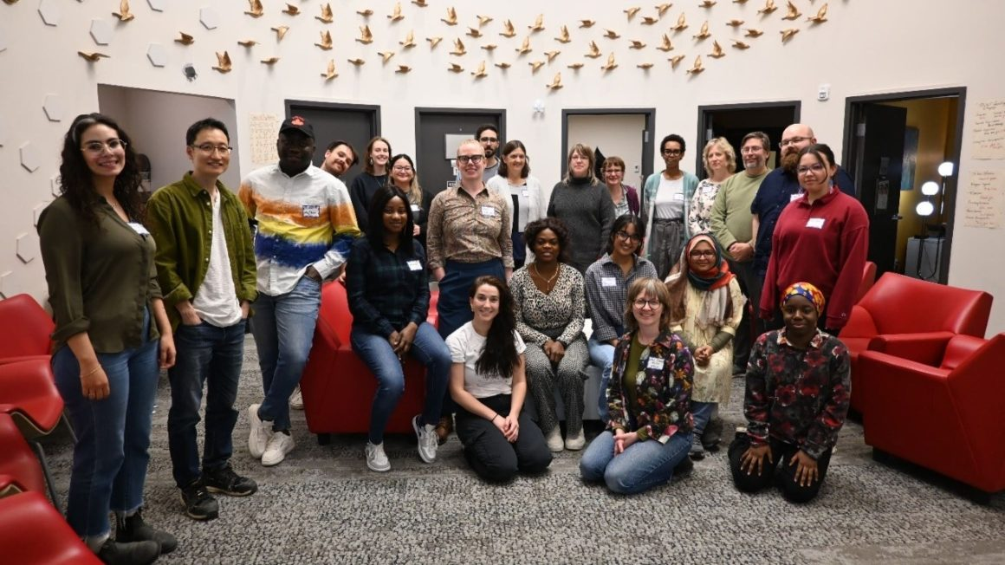
CBR Summer Institute participants and presenters. Photo by Jess Klassen.

Slide 31
RESEARCH EXCELLENCE, MOBILIZATION, AND IMPACT
Rupert’s Land Colloquium (May 23-25, 2024)
Centre for Transnational Mennonite Studies. “Subjects, Settlers, Citizens: The 1870s Mennonites in Historical Context” (October 4-5, 2024)

Slide 32
Inner-
This innovative sixteen week program enables Indigenous, non-Indigenous, and newcomer students to learn and work together within Winnipeg's inner-city. The program collaborates with community based inner-city organizations to cooperatively design work placements that meet students' skills and interests. Rooted in reconciliation, the program is a place for diverse students to wrestle with complex issues, better understand each other, gain work experience, and a post-secondary education credit.

Slide 33
RESEARCH EXCELLENCE, MOBILIZATION, & IMPACT
LECTURES, TALKS, ROUNDTABLES
New Directions in Classics
The popular Classics New Directions Series was back this year with talks by Dr. Heather Barkman, Dr. Pauline Ripat, Dr. Peter Miller, Dr. Paul Monaghan, and Dr. Cristiana Roffi of the University of Toronto for her talk Mother Earth: Ecofeminist Narratives in Ovid’s Metamorphoses.
CRiCS Research Talk Series
Conversations on Culture, Climate Justice, and Critical Hope (Winter 2025)
Cristina Bacchilega and Pauline Greenhill, Justice in 21st Century Fairy Tales and the Power of Wonder (April 11, 2025)
Political Science Lecture Series
New Constitutional Trends and Alberta's 2021 Referendum on Equalization: Testing Canadian Federalism, Dr. Dave Guénette, Université de Sherbrooke, Oct. 23, 2024)

Slide 34
RESEARCH EXCELLENCE, MOBILIZATION, & IMPACT
LECTURES, TALKS, ROUNDTABLES
New Directions in Classics
The popular Classics New Directions Series was back this year with talks by Dr. Heather Barkman, Dr. Pauline Ripat, Dr. Peter Miller, Dr. Paul Monaghan, and Dr. Cristiana Roffi of the University of Toronto for her talk Mother Earth: Ecofeminist Narratives in Ovid’s Metamorphoses.
CRiCS Research Talk Series
Conversations on Culture, Climate Justice, and Critical Hope (Winter 2025)
Cristina Bacchilega and Pauline Greenhill, Justice in 21st Century Fairy Tales and the Power of Wonder (April 11, 2025)
Political Science Lecture Series
New Constitutional Trends and Alberta's 2021 Referendum on Equalization: Testing Canadian Federalism, Dr. Dave Guénette, Université de Sherbrooke, Oct. 23, 2024)

Slide 35
RESEARCH EXCELLENCE, MOBILIZATION, & IMPACT
Awards and Recognition
Dr. Peter Miller received the 2024 Arts Excellence in Scholarly/Creative Activity Award
Dr. Shailesh Shukla received the 2024 Arts Excellence in Teaching Award

Slide 36
RESEARCH EXCELLENCE, MOBILIZATION, & IMPACT
The Brothers Grimm Society of North America Interview Series interviewed Pauline Greenhill as the first Canadian scholar in the series in May 2024.
On Nov. 14, 2024, Jason Hannon, Department of Rhetoric, Writing, and Communications, hosted a book launch for Peter Ives’ book Rethinking Free Speech.
Mary Jane McCallum gave a presentation on her book, Brown Tom’s Schooldays

Slide 37
RESEARCH EXCELLENCE, MOBILIZATION, AND IMPACT
Dr. Mary Jane McCallum was awarded a 2024 Community Impact Award from the Association of Tribal Libraries, Archives and Museums in November 2024 for her co-authored book Nii Ndahlohke and an associated art exhibition.
Nii Ndahlohke / I Work also won an Exhibition of the Year Award at the 47th annual Galeries Ontario Galleries (GOG) Awards. Winners were announced at a gala in Toronto on December 3
“Published in 2022, Nii Ndahlohke weaves together oral histories, archival research, art to tell the story of forced child labour at Mount Elgin Industrial School in southern Ontario. The book is structured into two sections: the first focuses on boys’ work, including maintenance and farm labour, and the second examines girls’ work, such as cooking, cleaning, and laundry.”
https://news.uwinnipeg.ca/history-professors-research-into-residential-school-student-labour-wins-two-awards/

Slide 38
RESEARCH EXCELLENCE, MOBILIZATION, AND IMPACT
SSHRC Insight Grants (April 2024-2025)
Sharanpal Ruprai, Lead Applicant (Women’s and Gender Studies) – Desi+: Digital Artistic Productions by Queer Sikhs – $94,368
Peter J. Miller, Lead Applicant (Classics) – Classical Antiquity and Physical Culture – $69,337
Mary Jane Logan McCallum, Lead Applicant (History) – Legacies of Colonial Violence: Munsee Land and History in Southwestern Ontario – $339,884
Amy S. Desroches, Lead Applicant (Psychology) – Reading and math achievement in the early school years – $94,999
Stephen D. Smith, Co-Applicant (Psychology)
Stephanie Bugden, Co-Applicant (Psychology)
Harinder S. Aujla, Collaborator (Psychology)

Slide 39
RESEARCH EXCELLENCE, MOBILIZATION, AND IMPACT
SSHRC Insight Grants, continued
Celiese Lypka, Lead Applicant (English) – Living Lost: Writings on Métis Kinship, Loss, & Home – $74,138
Genderplay, gender euphoria and contexts of oppressions: Experiences of queer youth in central Canada (Lead at UManitoba) – $313,864
Hope McIntyre, Collaborator (Theatre and Film)
Transformative Encounters: Gender and Sexuality Pedagogies in Canada (Lead at ConcordiaU) – $327,938
Angela Failler, Co-Applicant (Women’s and Gender Studies)
Aarzoo Singh, Co-Applicant (Women’s and Gender Studies)
Perceiving Trustworthiness on Black and White Faces: A Black Perspective (Lead at YorkU) – $199,785
Justin P. Friesen, Co-Applicant (Psychology)

Slide 40
RESEARCH EXCELLENCE, MOBILIZATION, AND IMPACT SSHRC Insight Development Grants
Adina Balint, Lead Applicant (Modern Languages and Literatures) – Climate Uncertainty in Twenty-First Century Literature in Canada, Quebec and Brazil – $51,053
Leah Kuragano, Lead Applicant (History) – Colonial Apprehension: Hawaiian Indigeneity and U.S. Popular Culture – $66,360
Mary Adedayo, Lead Applicant (Applied Computer Science) – Artificial Intelligence and Algorithmic Policing in Canada – $54,200
Kevin Walby, Co-Applicant (Criminal Justice)

Slide 41
RESEARCH EXCELLENCE, MOBILIZATION, AND IMPACT
SSHRC Connection Grants
Mary Jane McCallum, Collaborator (History) – To Find Our Wampum All White: Reflections and Responses to the Grand General Indian Council of 1858 (Lead at York University) – $44,851
Marcella Cassiano, Lead Applicant (Criminal Justice) – Perverting Justice: Law, Crime, Justice, and the Perverse – $23,286
Bronwyn Dobchuk-Land, Co-Applicant (Criminal Justice)
Katharina Maier, Co-Applicant (Criminal Justice)
Kelly Gorkoff, Co-Applicant (Criminal Justice)
Kevin Walby, Co-Applicant (Criminal Justice)
Steven Kohm, Co-Applicant (Criminal Justice)
Félix Mathieu, Co-Applicant (Political Science) – L'Acte de Québec après 250 ans : souligner le passé, fonder l'avenir – $24,938

Slide 42
RESEARCH EXCELLENCE, MOBILIZATION, AND IMPACT
SSHRC Partnership Engage Grant
Shauna MacKinnon (Urban and Inner-City Studies) – Developing a typology to compare social housing systems – $24,878
Kevin Walby, Co-Applicant (Criminal Justice) – Shaping Meanings of Confinement in Prison Tourism: Exhibit Curation, Self-Guided Tours and Visitor Engagement at the Peel Art Gallery Museum and Archives – $25,000

Slide 43
Non-Tri-Agency Funding
Manitoba Medical Service Foundation
Marcella Cassiano Siqueira (Criminal Justice) – Employee Wellness among Public Safety Communicators in Manitoba – $45,000

Slide 44
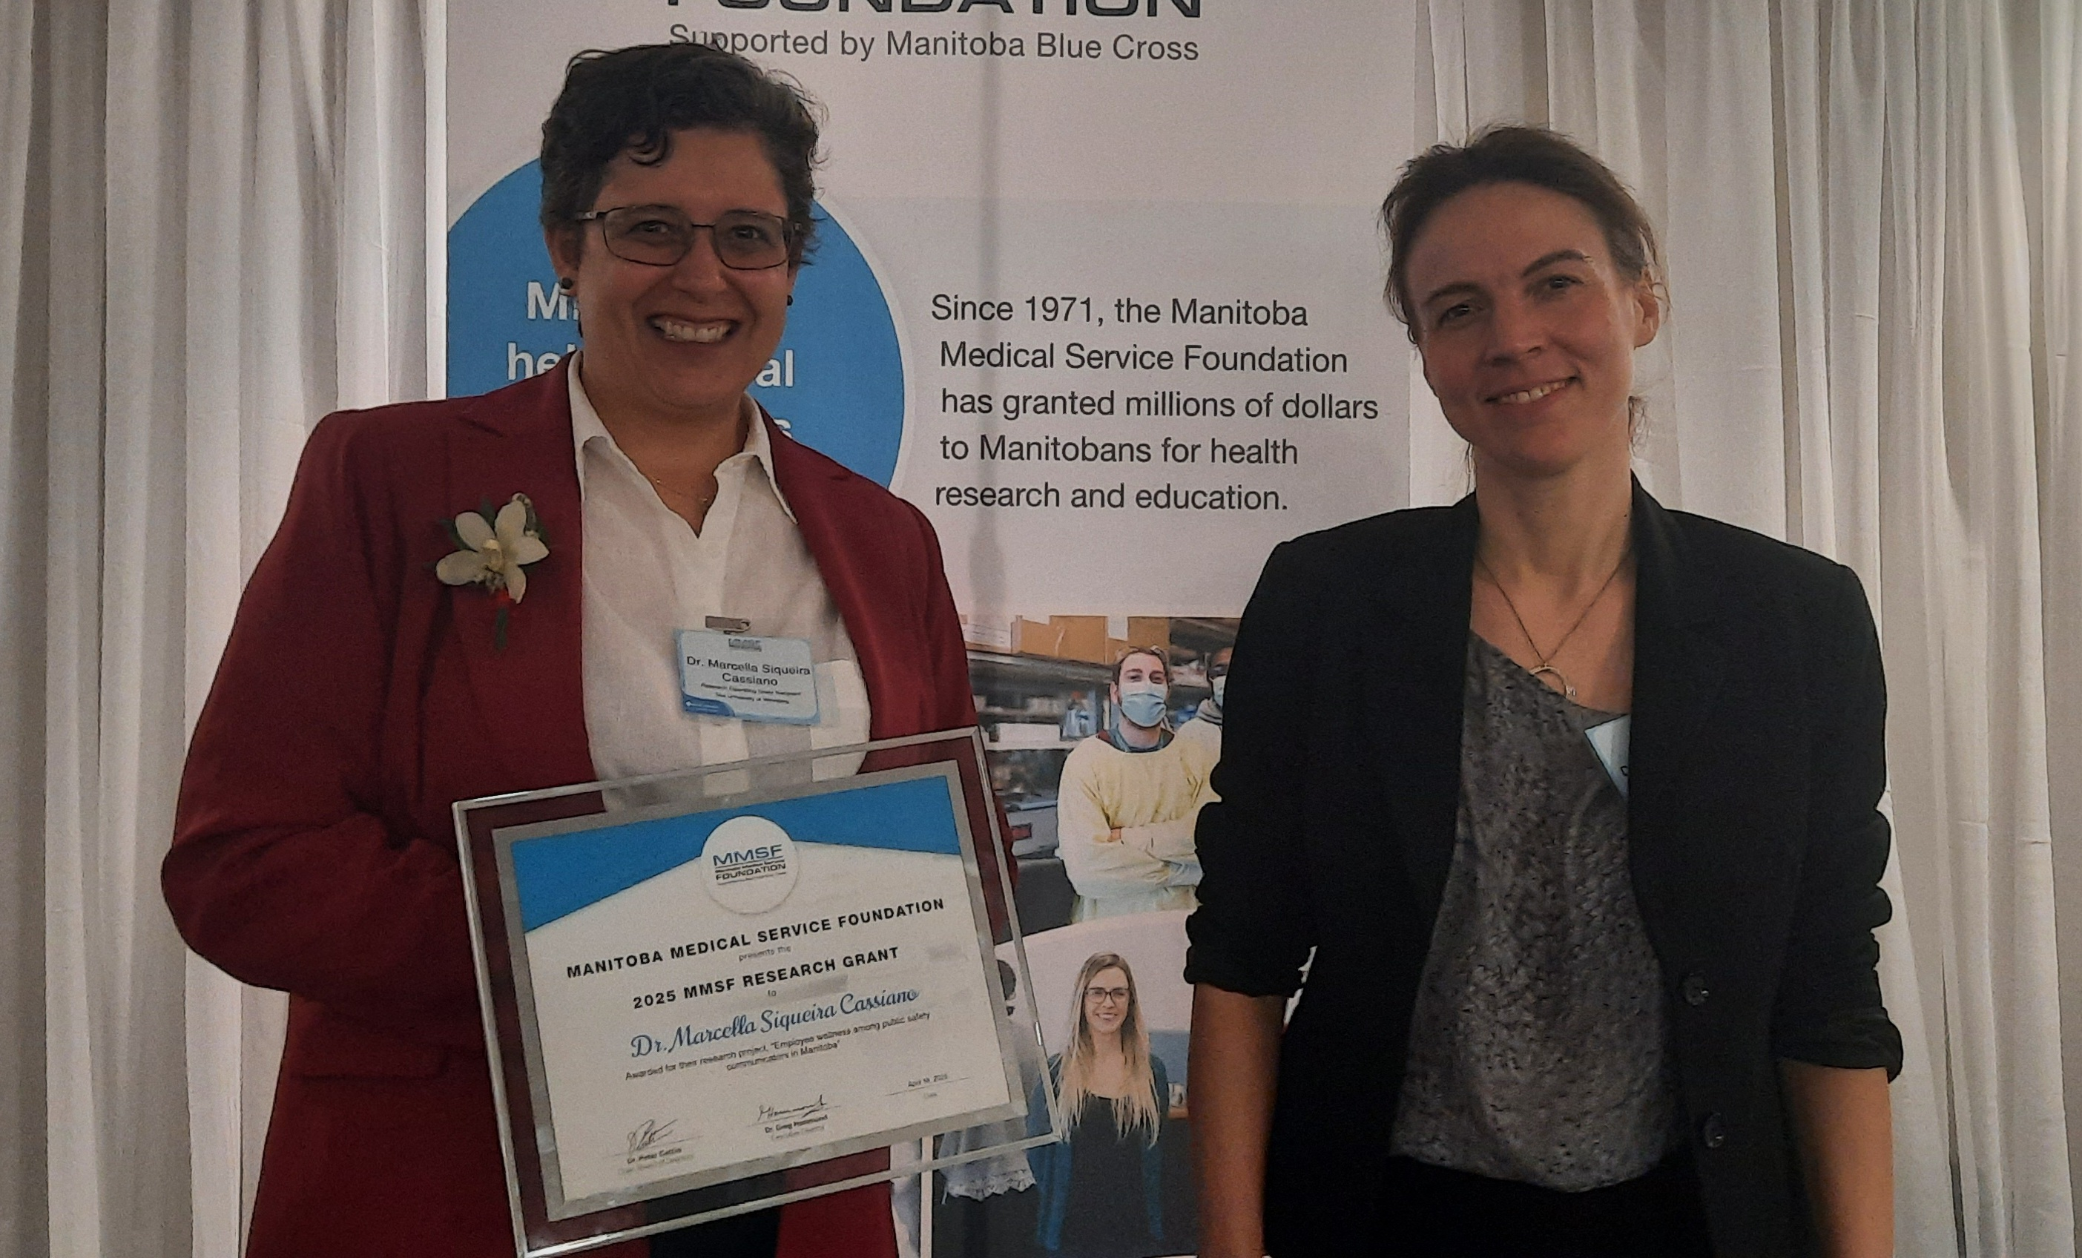

Slide 45
RESEARCH EXCELLENCE, MOBILIZATION, AND IMPACT
Mitacs: Business Strategy Internship
Shauna MacKinnon (Urban and Inner-City Studies) – Social Enterprise Enclave – $30,000
Shauna MacKinnon (Urban and Inner-City Studies) – Community Outreach Support –$30,000
Shauna MacKinnon (Urban and Inner-City Studies) – MIA Research and Development on Inuit Socioeconominc Circumstance – $60,000
Shauna MacKinnon (Urban and Inner-City Studies) – Makoon Transition; Case Management, client intake, clan wellness, family support worker – $60,000
Shauna MacKinnon (Urban and Inner-City Studies) – Brighter Days Youth Nature Club –$15,000
Shauna MacKinnon (Urban and Inner-City Studies) – Newcomer and Sponsor Programming Support – $60,000
Shauna MacKinnon (Urban and Inner-City Studies) – Project Oulu – $30,000
Shauna MacKinnon (Urban and Inner-City Studies) – 1JustCity West Broadway Drop-in outreach and programming support – $30,000
Shauna MacKinnon (Urban and Inner-City Studies) – Harvest Manitoba Voices – $47,250
Shauna MacKinnon (Urban and Inner-City Studies) – Developing Support Worker Tools – $15,000

Slide 46
RESEARCH EXCELLENCE, MOBILIZATION, AND IMPACT
Contracts
Manitoba Non-profit Housing Association Inc.
Scott McCullough (Criminal Justice) – Mapping Manitoba Social Housing – Research Services Agreement – $500
Canadian Centre for Housing Rights
Michelle Owen (Women’s and Gender Studies) – The Right to Housing for Tenants with Disabilities in Canada – Transfer of funds agreement – $21,500
The State of Michigan via Memorial University of Newfoundland
Marcella Cassiano (Criminal Justice) – MDOC Employee Wellness Research Study - Transfer Agreement – $79,196 USD Per Year 1 Budget – (Max $246,972 USD over duration of project)
Manitoba Research Alliance
Shauna MacKinnon (Urban and Inner-City Studies) – Right to Housing Research Program – Fund Transfer Agreement – $150,000

Slide 47
Internal Award | Faculty | Total Number | Total Amount
Major Research Grant
 | Arts | 13 | $89,440
Discretionary Grant
 | Arts | 27 | $39,275
Distinguished Faculty Travel Award
 | Arts | 1 | $1,031
Travel Grant
 | Arts | 33 | $52,025
Partnership Development Grant
 | Arts | 2 | $3,000
Research Workshop and Conference Grant
 | Arts | 5 | $10,000
Knowledge Mobilization and Community Impact Grant
 | Arts | 4 | $19,050
SSHRC Explore/Exchange Grant
 | Arts | 19 | $83,452
Research Grant in Lieu of Salary
 | Arts | 2 | $27,985
Conference Sponsorship Fund
 | Arts | 2 | $10,000
Indirect Costs of Research Fund

Slide 48
BUDGET

Slide 49
OVERALL BUDGET FIGURES, 2024-25
*Non-salary expenses are % of the total Arts Budget.
TOTAL | 29,458,541
SALARY AND BENEFITS | 29,052,032
NON-SALARY EXPENSES* | 406,510

Slide 50
ARTS STIPENDS FOR 2024-25
 | 2024-25
UWFA-CAS | 2,382,365
MOD Assistants | 30,000
Lab Instructors | 85,000
 | 2,497,365

Slide 51
NON-SALARY EXPENSES
TRAVEL | $78,000 | MOVING EXPENSES AND OTHER COSTS ASSOCIATED WITH HIRING, INCLUDING INTERVIEWS
BUSINESS MEETINGS | $18,446 | SUPPORT FOR MEETINGS, EVENTS
LAB FEES | $115,491 | DISTRIBUTED TO DEPARTMENTS TO COVER LAB-RELATED EXPENSES, INCLUDING SALARIES FOR LAB MONITORS, STUDENT CREWS, ETC.

Slide 52
NON-SALARY EXPENSE: CAPITAL
$30,000
Replacement blinds (3), software subscriptions, office chair, Arts swag, furniture, washer, chairs for computer lab, plotter (THFM)

Slide 53
Fall 2024 FCEs by Faculty

Slide 54
Fall 2024 Student Count by Faculty

Slide 55
Winter 2025 FCEs by Faculty

Slide 56
Winter 2025 Student Count by Faculty

Slide 57
Thank you!
To Lisa McLean, Jackie Benson, Nyala Ali,James Hanley, Chris MacDonnell, and Lauren Bosc for assisting with this report!

